Slide 1
Introduction to nodejs

Slide 2
What is Node.js?
Node.js is an open source server environment
Node.js is free
Node.js runs on various platforms (Windows, Linux, Unix, Mac OS X, etc.)
Node.js uses JavaScript on the server

Slide 3
Why Node.js?
Here is how PHP or ASP handles a file request:
Sends the task to the computer's file system.
Waits while the file system opens and reads the file.
Returns the content to the client.
Ready to handle the next request.

Slide 4
Why Node.js?
Here is how Node.js handles a file request:
Sends the task to the computer's file system.
Ready to handle the next request.
When the file system has opened and read the file, the server returns the content to the client.

Slide 5
What Can Node.js Do?
Node.js can generate dynamic page content
Node.js can create, open, read, write, delete, and close files on the server
Node.js can collect form data
Node.js can add, delete, modify data in your database

Slide 6
What is a Node.js File?
Node.js files contain tasks that will be executed on certain events
A typical event is someone trying to access a port on the server
Node.js files must be initiated on the server before having any effect
Node.js files have extension ".js"

Slide 7
Download Node.js
The official Node.js website has installation instructions for Node.js: https://nodejs.org

Slide 8
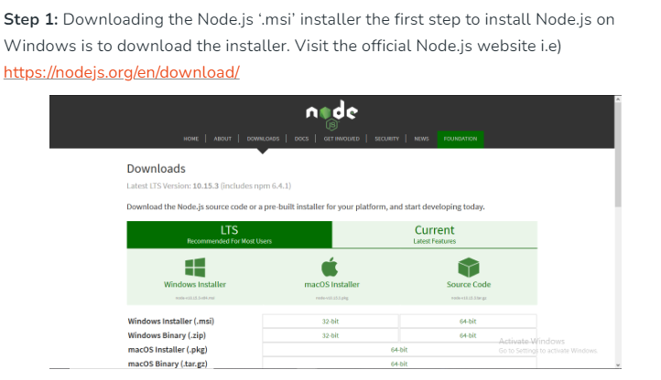
Installing Node On Windows

Slide 9
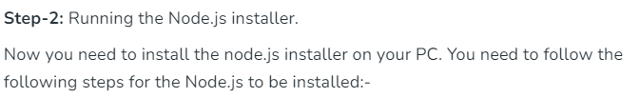
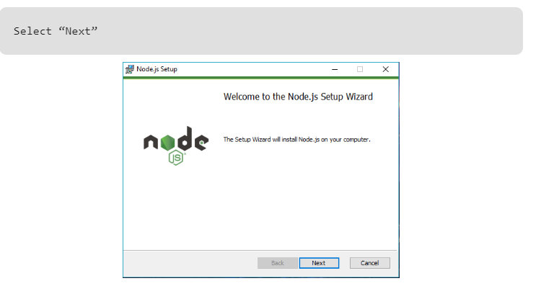
Installing Node On Windows

Slide 10
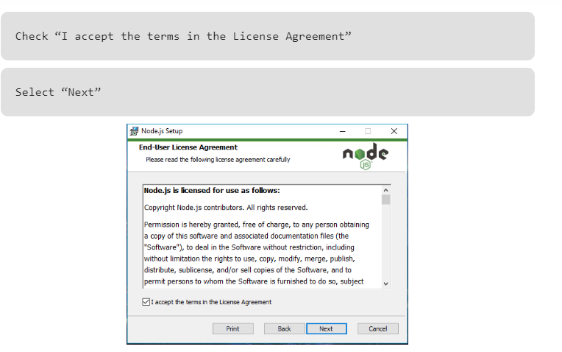
Installing Node On Windows

Slide 11
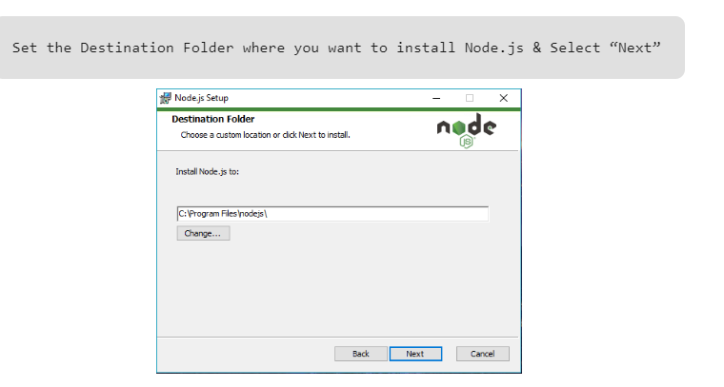
Installing Node On Windows

Slide 12
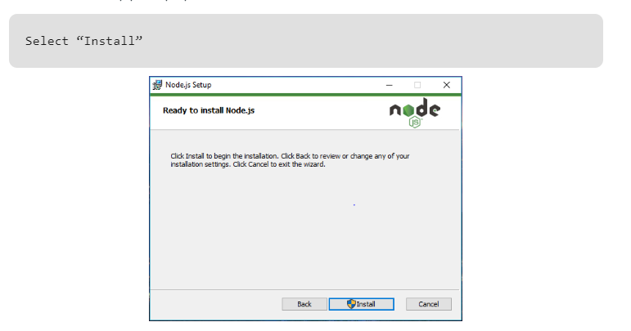
Installing Node On Windows

Slide 13
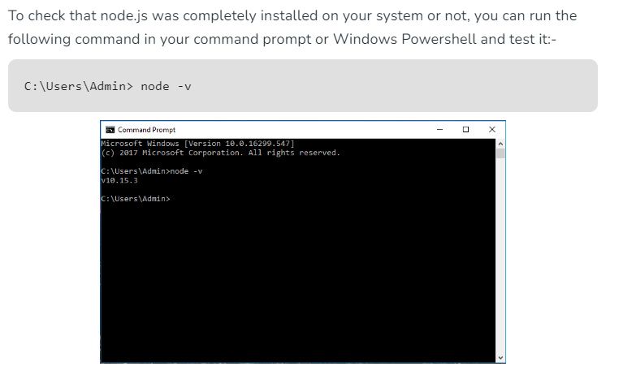
Verify that Node.js was properly installed or not.

Slide 14
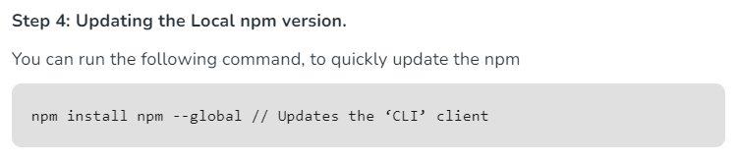

Slide 15
What is a Module in Node.js?
Consider modules to be the same as JavaScript libraries.
A set of functions you want to include in your application.

Slide 16
Built-in Modules
Node.js has a set of built-in modules which you can use without any further installation.
Look at our Built-in Modules Reference for a complete list of modules.

Slide 17
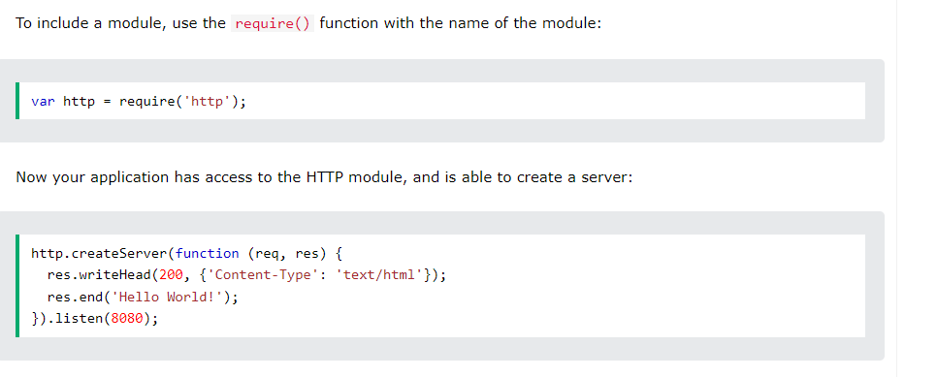
Include Modules

Slide 18
Example 1
var http = require('http');
//create a server object:
http.createServer(function (req, res) {
res.write('Hello World!'); //write a response to the client
res.end(); //end the response
}).listen(8080); //the server object listens on port 8080

Slide 19
Example 2
// Import the 'http' module
const http = require('http');
// Define the port number to listen on
const port = 3000;
// Create an HTTP server
const server = http.createServer((req, res) => {
// Set the response header with a 200 OK status and text/plain content type
res.writeHead(200, { 'Content-Type': 'text/plain' });
// Send the "Hello, World!" message to the response
res.end('Hello, World!\n');
});
// Start the server and listen on the specified port
server.listen(port, () => {
console.log(`Server running at http://localhost:${port}/`);
});

Slide 20
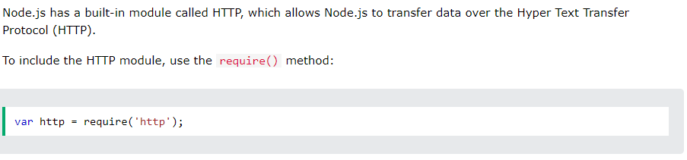
The Built-in HTTP Module

Slide 21
Node.js as a Web Server
The HTTP module can create an HTTP server that listens to server ports and gives a response back to the client.
Use the createServer() method to create an HTTP server:

Slide 22
Node.js as a Web Server
var http = require('http');
//create a server object:
http.createServer(function (req, res) {
res.write('Hello World!'); //write a response to the client
res.end(); //end the response
}).listen(8080); //the server object listens on port 8080

Slide 23
How to file read data
// Import the 'fs' (file system) module
const fs = require('fs');
// Specify the file path (replace with the path to your file)
const filePath = 'mohsin.txt';
// Read the contents of the file asynchronously
fs.readFile(filePath, 'utf8', (err, data) => {
// Check for errors
if (err) {
console.error(`Error reading file: ${err.message}`);
return;
}
// Output the file content to the console
console.log('File Content:');
console.log(data);
});
// This message will be printed before the file is read (asynchronous operation)
console.log('Reading file...');

Slide 24
Date and time display
const http = require('http');
// Create an HTTP server
const server = http.createServer((req, res) => {
// Set the content type to HTML
res.writeHead(200, { 'Content-Type': 'text/html' });
// Get the current date and time
const currentDate = new Date();
// Format the date and time as a string
const formattedDateTime = currentDate.toLocaleString();
// Send an HTML response with the formatted date and time
const htmlResponse = `
<html>
<head>
<title>Current Date and Time</title>
</head>
<body>
<h1>Current Date and Time</h1>
<p>${formattedDateTime}</p>
</body>
</html>
`;
;
});

Slide 25
// Send the HTML response to the client
res.end(htmlResponse);
});
// Set the port number to listen on
const port = 3000;
// Start the server and listen on the specified port
server.listen(port, () => {
console.log(`Server running at http://localhost:${port}/`)

